Slide 1
National Standard 10 Update
Commercial Fishing Safety Advisory Committee Washington, DC
Office of Sustainable Fisheries
August 14, 2013

Slide 2
National Standard 10
“Conservation and management measures shall, to the extent practicable, promote the safety of human life at sea.” (MSA section 301(a))
Published Advance Notice of Proposed Rulemaking on April 21, 2011 (76 FR 22342).
90 day public comment period ending July 20, 2011.
Held 5 public meetings.
Received: 33 written comments; 36 oral comments.

Slide 3
National Standard 10
Comments can be viewed on the Federal e-rulemaking portal: www.regulations.gov.
To view the comments, enter "NOAA-NMFS-2011-0068" in the box that reads "Enter keyword or ID”
http://www.nmfs.noaa.gov/sfa/laws_policies/national_standards/ns10_revisions.html
Developing proposed rule.

Slide 4
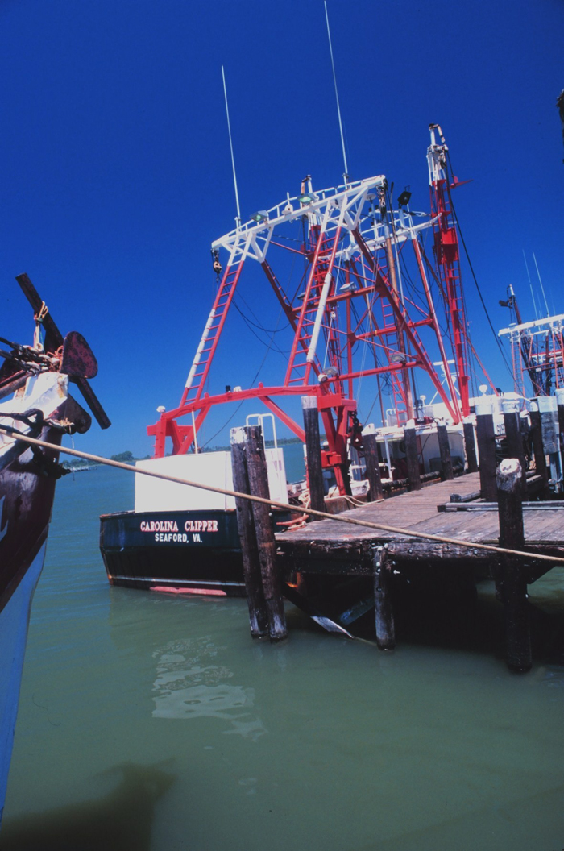
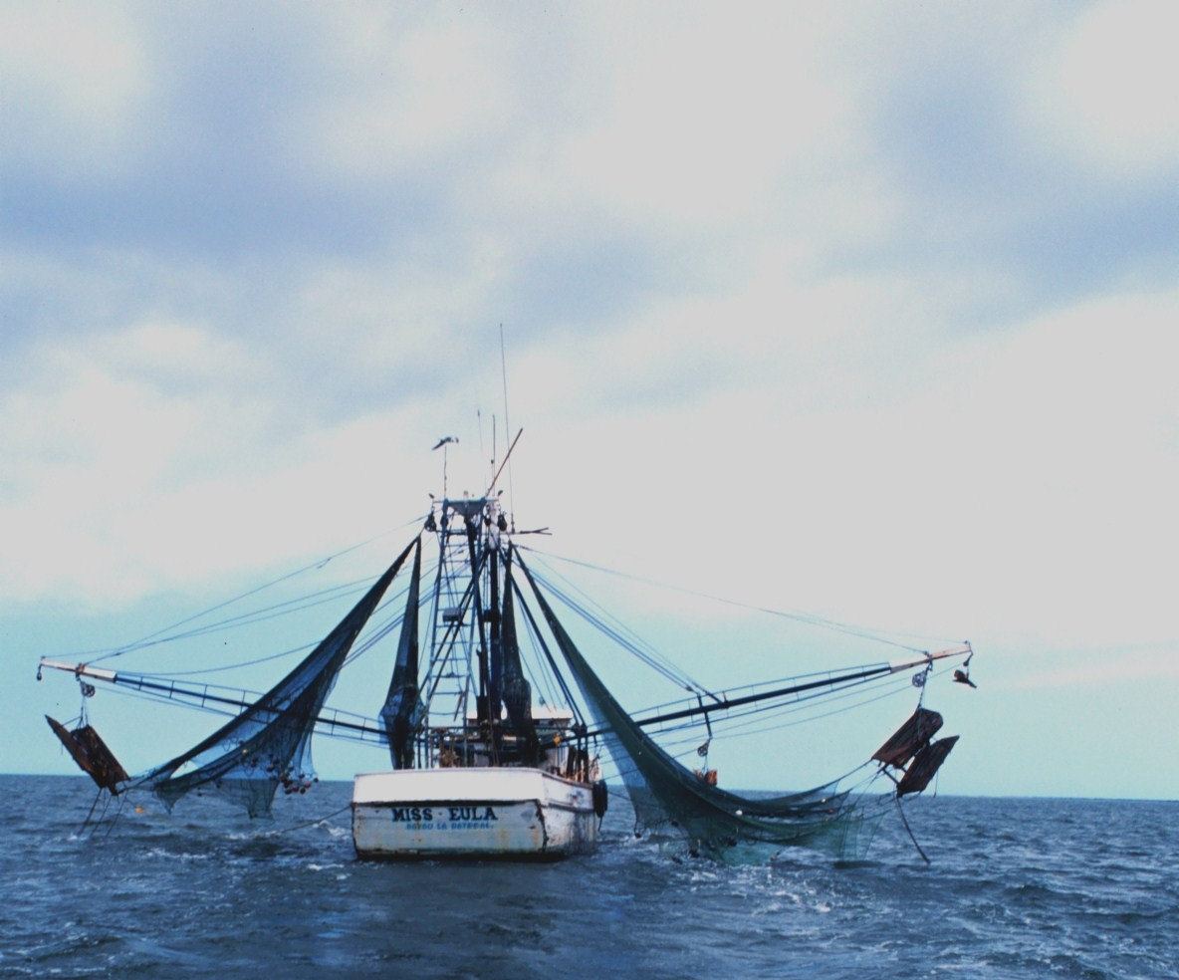
National Standard 10 Projects
Conducted two risk assessments:
  Atlantic Scallop Fishery
  Gulf of Mexico Shrimp Fishery

Slide 5
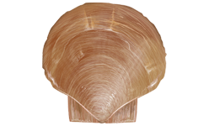
Atlantic Scallop Fishery
Maine to North Carolina.
Predominately in Federal waters.
New England Fishery Management Council – Scallop Fishery Management Plan.
March 1-Febuary 28th
Operates in cold water.
Permit types:
  Limited Access – 8 permit categories.
    Predominately full-time dredge.
    > 70 ft
    In 2010, 354 active vessels.
  Limited Access General Category – 3 permit categories.
    < 50 ft
    In 2010, 279 active vessels.

Slide 6
Atlantic Scallop Fishery (2000 – 2010)

Slide 7
Atlantic Scallop Fishery (2000 – 2010)
Activity at time of fatal incident | # of Fatalities | # of Fatal Incidents
Fishing | 31 | 17
Transit Inbound or Outbound | 6 | 5
Unknown (either fishing or transiting) | 4 | 1
Total | 41 | 23
Type of fatal incidents | # of Fatalities | # of Fatal Incidents
Vessel disaster | 30 | 12
Fall Overboard | 8 | 8
On-board Injury | 3 | 3
Total | 41 | 23

Slide 8
Atlantic Scallop Fishery (2000 – 2010)
Type of Scallop Permit | Type of Fatal Incident |  |  | Total # of Fatal Incidents
 | Vessel Disaster | On-board Injury | Fall Overboard
Limited Access - Full-Time: Authorized to use trawl nets |  |  | 1 | 1
Limited Access - Full-Time (dredge) | 3 | 2 | 5 | 10
Limited Access - Full-Time small dredge | 1 |  |  | 1
Limited Access - Part-Time small dredge |  |  | 1 | 1
General Category | 4 |  |  | 4
General Category (VMS required) | 3 |  | 1 | 4
Limited Access General Category IFQ Permit | 1 |  |  | 1
No Federal Permit (assume participating in state scallop fishery) |  | 1 |  | 1
 |  |  | sum | 23

Slide 9
Atlantic Scallop Fishery (2000 – 2010)
Vessel Length | # of Fatalities | Type of Incident |  |  | # of Fatal Incidents
 |  | Vessel Disaster | On-board Injury | Fall Overboard
0-29 | 0 |  |  |  | 0
30-39 | 2 | 1 |  |  | 1
40-49 | 9 | 3 | 1 |  | 4
50-59 | 3 | 3 |  |  | 3
60-69 | 5 | 2 |  |  | 2
70-79 | 19 | 3 | 2 | 5 | 10
80-89 | 2 |  |  | 2 | 2
90-99 | 1 |  |  | 1 | 1
Total | 41 | 12 | 3 | 8 | 23

Slide 10
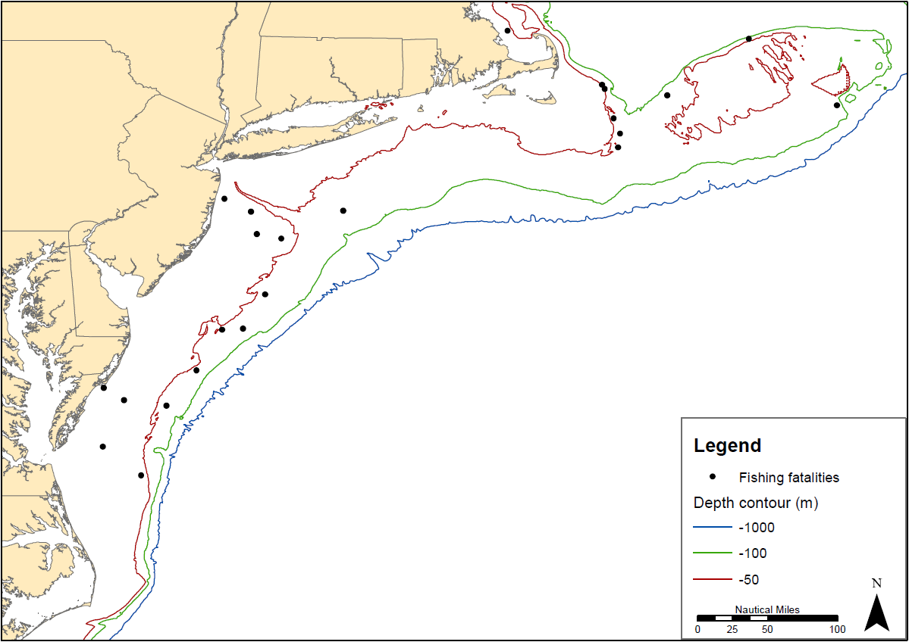

Slide 11
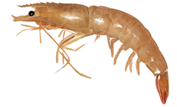
Gulf of Mexico Shrimp Fishery
Target: brown, white, pink, and royal red shrimp.
Fishery occurs in state and Federal waters.
Gulf of Mexico Fishery Management Council – Shrimp Fishery Management Plan.
1806 active vessels
77% have steel hull
55% have onboard freezing capacity; 45% use ice.
Average crew size: 3.3
Average vessel length: 69 ft

Slide 12
Gulf of Mexico Shrimp Fishery (2000 – 2010)

Slide 13
Gulf of Mexico Shrimp Fishery (2000 – 2010)
Activity at time of fatal incident | # of Fatalities | # of Fatal Incidents
Fishing | 33 | 33
Anchored | 9 | 7
Transit Inbound or Outbound | 6 | 5
Moored | 1 | 1
Unknown | 3 | 3
Total | 52 | 49

Slide 14
Gulf of Mexico Shrimp Fishery (2000 – 2010)
Accident sub-category | Diving accident | Man overboard | On-board injury | Vessel disaster | Total
Air quality |  |  | 1 |  | 1
Electrocution |  |  | 1 |  | 1
Struck by gear |  |  | 2 |  | 2
Gear entanglement |  | 1 | 6 |  | 7
Climbing accident |  | 2 |  |  | 2
Vessel motion/lost balance |  | 4 |  |  | 4
Unknown | 1 | 17 |  |  | 18
Diving accident | 4 |  |  |  | 4
Collision/allision |  |  |  | 2 | 2
Fire/explosion |  |  |  | 1 | 1
Flooding |  |  |  | 1 | 1
Instability |  |  |  | 3 | 3
Weather |  |  |  | 3 | 3
Total | 5 | 24 | 10 | 10 | 49
Percentage | 10.2% | 49.0% | 20.4% | 20.4% | 100%

Slide 15
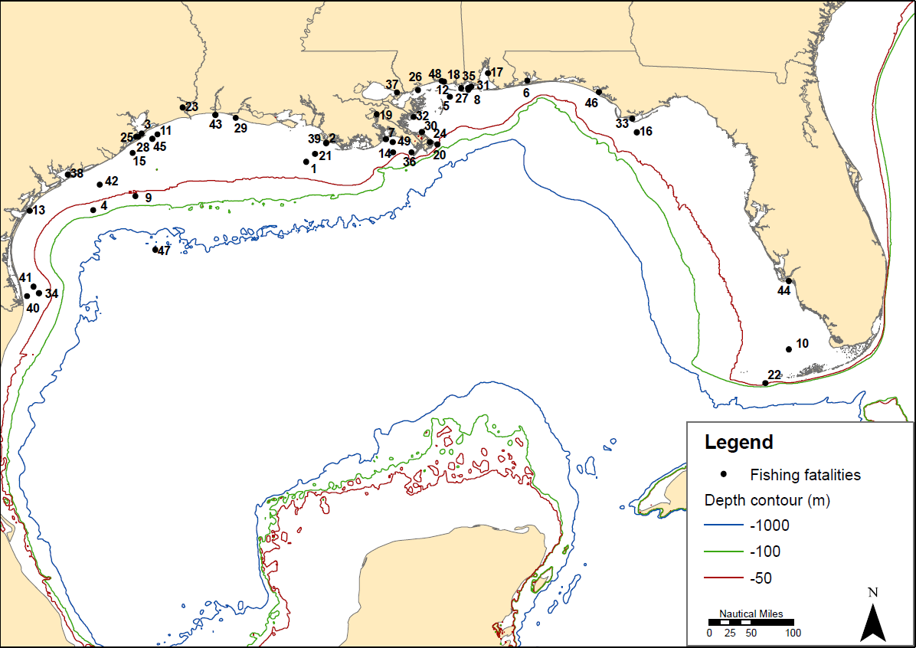

Slide 16
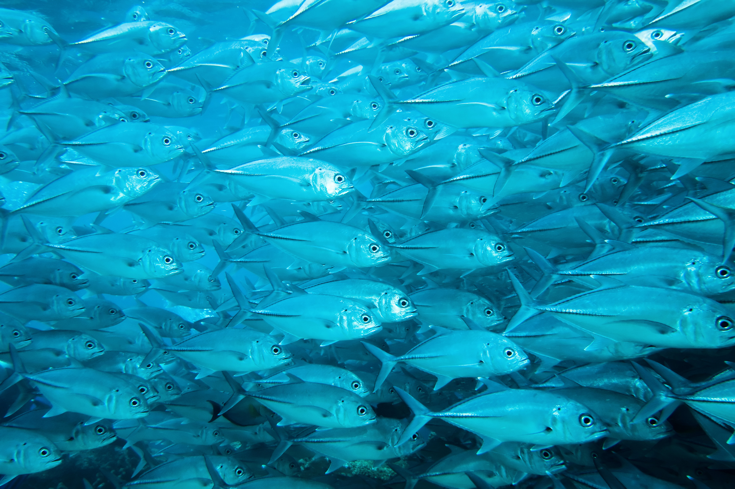
Questions

